Slide 1
“THEORY OF AUTOMATA”
NFA with Null String

Slide 2
Summary
Applications of complementing and incrementing machines, Equivalent machines, Moore equivalent to Mealy, proof, example, Mealy equivalent to Moore, proof, example

Slide 3
Applications of Incrementing and Complementing machines
1’s complementing and incrementing machines which are basically Mealy machines are very much helpful in computing. The incrementing machine helps in building a machine that can perform the addition of binary numbers. Using the complementing machine along with incrementing machine, one can build a machine that can perform the subtraction of binary numbers, as shown in the following method

Slide 4
Subtracting a binary number from another
Method
To subtract a binary number b from a binary number a Add 1’s complement of b to a (ignoring the overflow, if any) Increase the result, in magnitude, by 1 (use the incrementing machine ). Ignoring the overflow if any.
Note: If there is no overflow in (1). Take 1’s complement once again in (2), instead. This situation occurs when b is greater than a, in magnitude. Following is an example of subtraction of binary numbers

Slide 5
Example
To subtract the binary number 101 from the binary number 1110, let
a = 1110 and b = 101 = 0101.
(Here the number of digits of b are equated with that of a)
Adding 1’s complement (1010) of b to a.
1110
+1010
11000 which gives 1000 (ignoring the overflow)
Using the incrementing machine, increase the above result 1000, in magnitude, by 1
1000
+1
1001 which is the same as obtained by ordinary subtraction.
Note : It may be noted that the above method of subtraction of binary numbers may be applied to subtraction of decimal numbers with the change that 9’s complement of b will be added to a, instead in step (1).

Slide 6
Equivalent machines
Two machines are said to be equivalent if they print the same output string when the same input string is run on them.
Remark:
Two Moore machines may be equivalent. Similarly two Mealy machines may also be equivalent, but a Moore machine can’t be equivalent to any Mealy machine. However, ignoring the extra character printed by the Moore machine, there exists a Mealy machine which is equivalent to the Moore machine.
Theorem
For every Moore machine there is a Mealy machine that is equivalent to it (ignoring the extra character printed by the Moore machine).

Slide 7
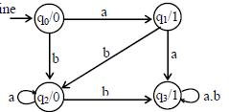
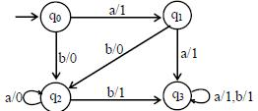
Example
Consider the following Moore machine
Using the method described earlier, the above machine may be equivalent to the following Mealy machine

Slide 8
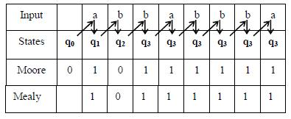
Running the string abbabbba on both the machines, the output string can be determined by the following table

Slide 9
Theorem
For every Mealy machine there is a Moore machine that is equivalent to it (ignoring the extra character printed the Moore machine).
Proof
Let M be a Mealy machine. At each state there are two possibilities for incoming transitions The incoming transitions have the same output character. The incoming transitions have different output characters. If all the transitions have same output characters, then shift that character to the corresponding state. If all the transitions have different output characters, then the state will be converted to as many states as the number of different output characters for these transitions, which shows that if this happens at state q_{i} then q_{i}
will be converted to q_{i}¹ and q_{i}² i.e. if at q_{i} there are the transitions with two output characters then q_{i}¹ for one character and q_{i}² for other character. Shift the output characters of the transitions to the corresponding new states q_{i}¹ and q_{i}². Moreover, these new states q_{i}¹ and q_{i}² should behave like q_{i} as well. Continuing the process, the machine thus obtained, will be a Moore machine equivalent to Mealy machine M.

Slide 10
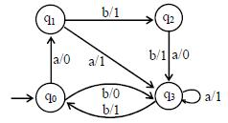
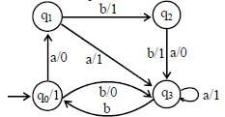
Example
Consider the following Mealy machine
Shifting the output character 1 of transition b to q₀

Slide 11
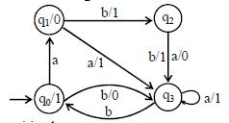
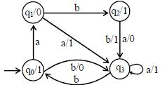
Shifting the output character 0 of transition a to q₁
Shifting the output character 1 of transition b to q₂

Slide 12
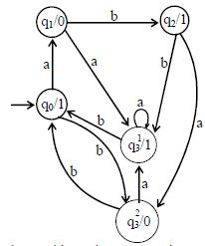
Splitting q₃ into q¹₃ and q²₃

Slide 13
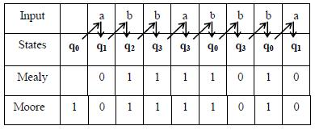
Running the string abbabbba on both the machines, the output strings can be determined by the following table

Slide 14
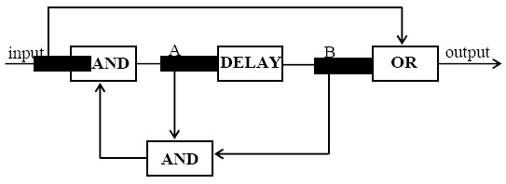
Example
Consider the following sequential circuit

Slide 15
The following four types of boxes are used in this circuit
NAND box (NOT AND): For the given input, it provides the complement of Boolean AND output.
DELAY box (Flip Flop box): It delays the transmission of signal along the wire by one step (clock pulse).
OR box: For the given input, it provides the Boolean OR output.
AND box: For the given input, it provides the Boolean AND output. The current in the wire is indicated by 1 and 0 indicates the absence of the current.
There are two points A and B w.r.t. to which following four states of the machine are identified according to the presence and absence of current at these points i.e.
q₀(A=0, B=0) (0,0)
q₁ (A=0, B=1) (0,1)
q₂ (A=1, B=0) (1,0)
q₃ (A=1, B=1) (1,1)

Slide 16
The operation of the circuit is such that the machine changes its state after reading 0 or 1. The transitions are determined using the following relations
new B = old A
new A = (input) NAND (old A AND old B)
output = (input) OR (old B)
It is to be noted that old A and old B indicate the presence or absence of current at A and B before inputting any better. Similarly new A and new B indicate the presence or absence of current after reading certain letter. At various discrete pulses of a time clock, input is received by the machine and the corresponding output string is generated. The transition at the state q₀ after reading the letter 0, can be determined, along with the corresponding output character as under
new B = old A = 0
new A = (input) NAND (old A AND old B)
= 0 NAND ( 0 AND 0) = 0 NAND 0
= 1
output = (input) OR (old B) = 0 OR 0 = 0

Slide 17
Thus after reading 0 at q₀ new B is 0 and new A is 1 i.e. machine will be at state (1,0) q₂ and during this process it’s output character will be 0.
The remaining action of this sequential circuit can be determined as shown by the following suggested transition table of the corresponding Mealy machine

Slide 18
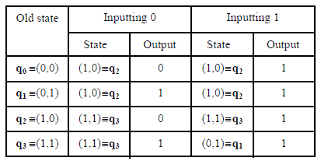

Slide 19
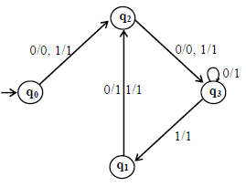
The corresponding transition diagram may be as follows
Note: It may be noted that if the string 00 is read at any state, it results in ending in state q₃.

Slide 20
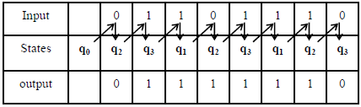
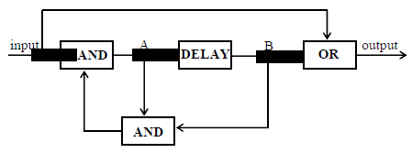
Running the string 01101110 on the previous machine, the output string can be determined by the following table
Following is a note regarding the sequential circuit under consideration.
It is to be noted that in this sequential circuit, delay box plays an important role in introducing four states of the machine.

Slide 21
Regular Expressions
As discussed earlier that if r₁, r₂ are regular expressions, corresponding to the languages L₁ and L₂ then the languages L₁ + L₂ , L₁L₂ and L₁* generated by r₁+ r₂, r₁r₂ and r₁*, are also regular languages. By TGs
If L₁ and L₂ are regular languages then L₁ and L₂ can also be expressed by some REs as well and hence using Kleene’s theorem, L₁ and L₂ can also be expressed by some TGs. Following are the methods showing that there exist TGs corresponding to L₁ + L₂, L₁L₂ and L₁*

Slide 22
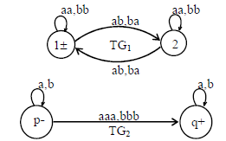
Example
Consider the following TGs

Slide 23
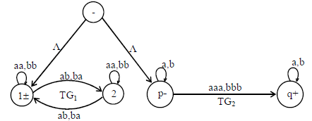
Following may be a TG accepting L₁+L₂

Slide 24
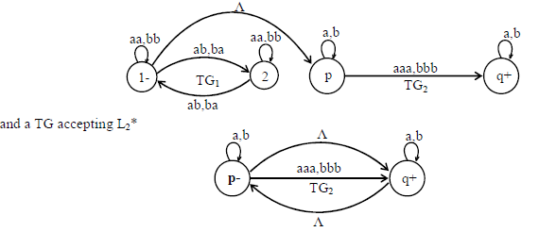
also a TG accepting L₁L₂ may be

Slide 25
Complement of a language
Let L be a language defined over an alphabet G, then the language of strings, defined over G, not belonging to L, is called Complement of the language L, denoted by L^{c} or L’.
Note
To describe the complement of a language, it is very important to describe the alphabet of that language over which the language is defined.
For a certain language L, the complement of L^{c} is the given language L i.e. (L^{c})^{c} = L

Slide 26

Theorem
If L is a regular language then, L^{c} is also a regular language.
Example
Let L be the language over the alphabet G = {a, b}, consisting of only two words aba and abb, then the FA accepting L may be

Slide 27

Converting final states to non-final states and old non-final states to final states, then FA accepting L^{c} may be

Slide 28

Theorem
Statement
If L₁ and L₂ are two regular languages, then L₁ U L₂ is also regular.
Using De-Morgan's law for sets

Slide 29
LINK
www.algorithm-code.com/wiki/Converts_NFA_to_DFA
www3.sympatico.ca/dbiggar/FA.home.html

